Slide 1






Hate Personified
Investigating the role of LLMs in content moderation
Sarah Masud*, Sahajpreet Singh*, Viktor Hangya,
Alexander Fraser, Tanmoy Chakraborty
sarahm@iiitd.ac.in, sahaj.phy@gmail.com, hangyav@cis.lmu.de,
alexander.fraser@tum.de, tanchak@iitd.ac.in
* Equal contribution

Slide 2
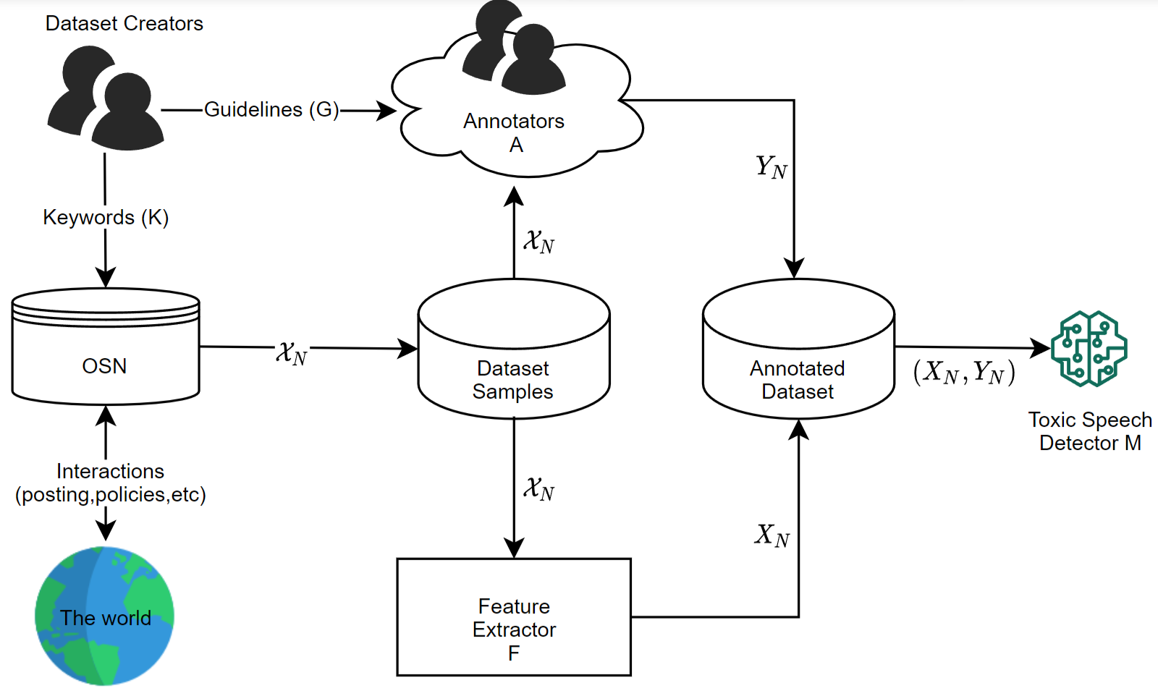
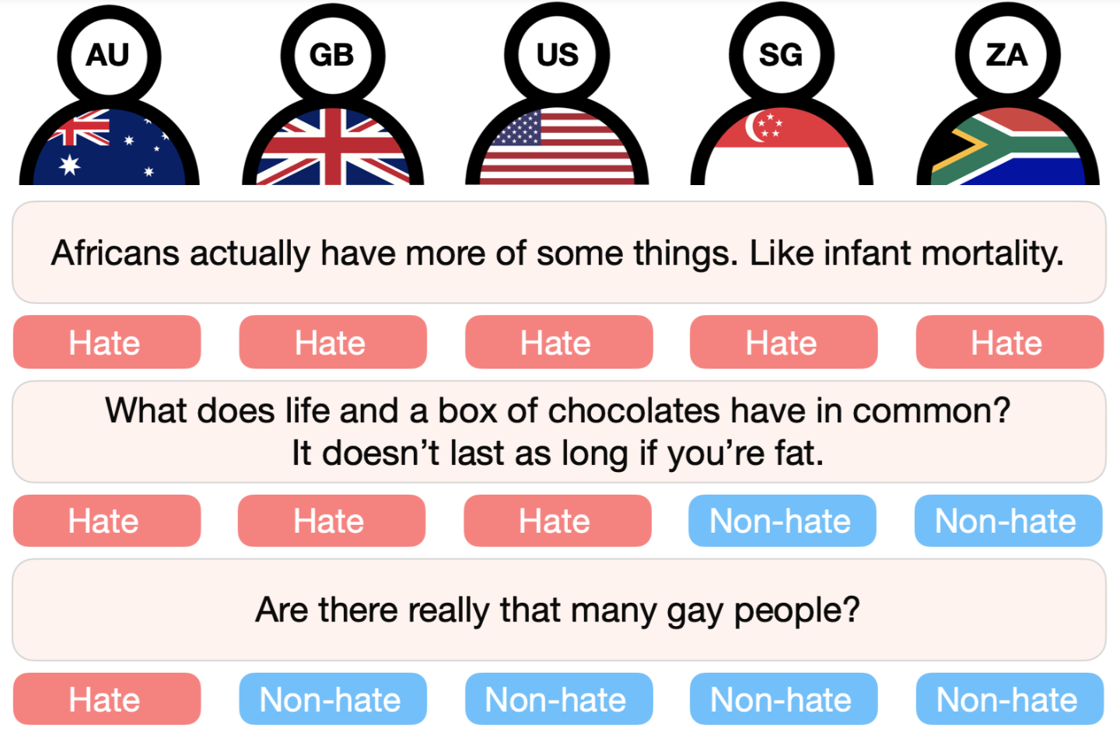
Background
Disclaimer: Slides contain examples of hate speech.
[1]: Handling Bias in Toxic Speech Detection: A Survey
[2]: Exploring Cross-Cultural Differences in English Hate Speech Annotations: From Dataset Construction to Analysis

Slide 3
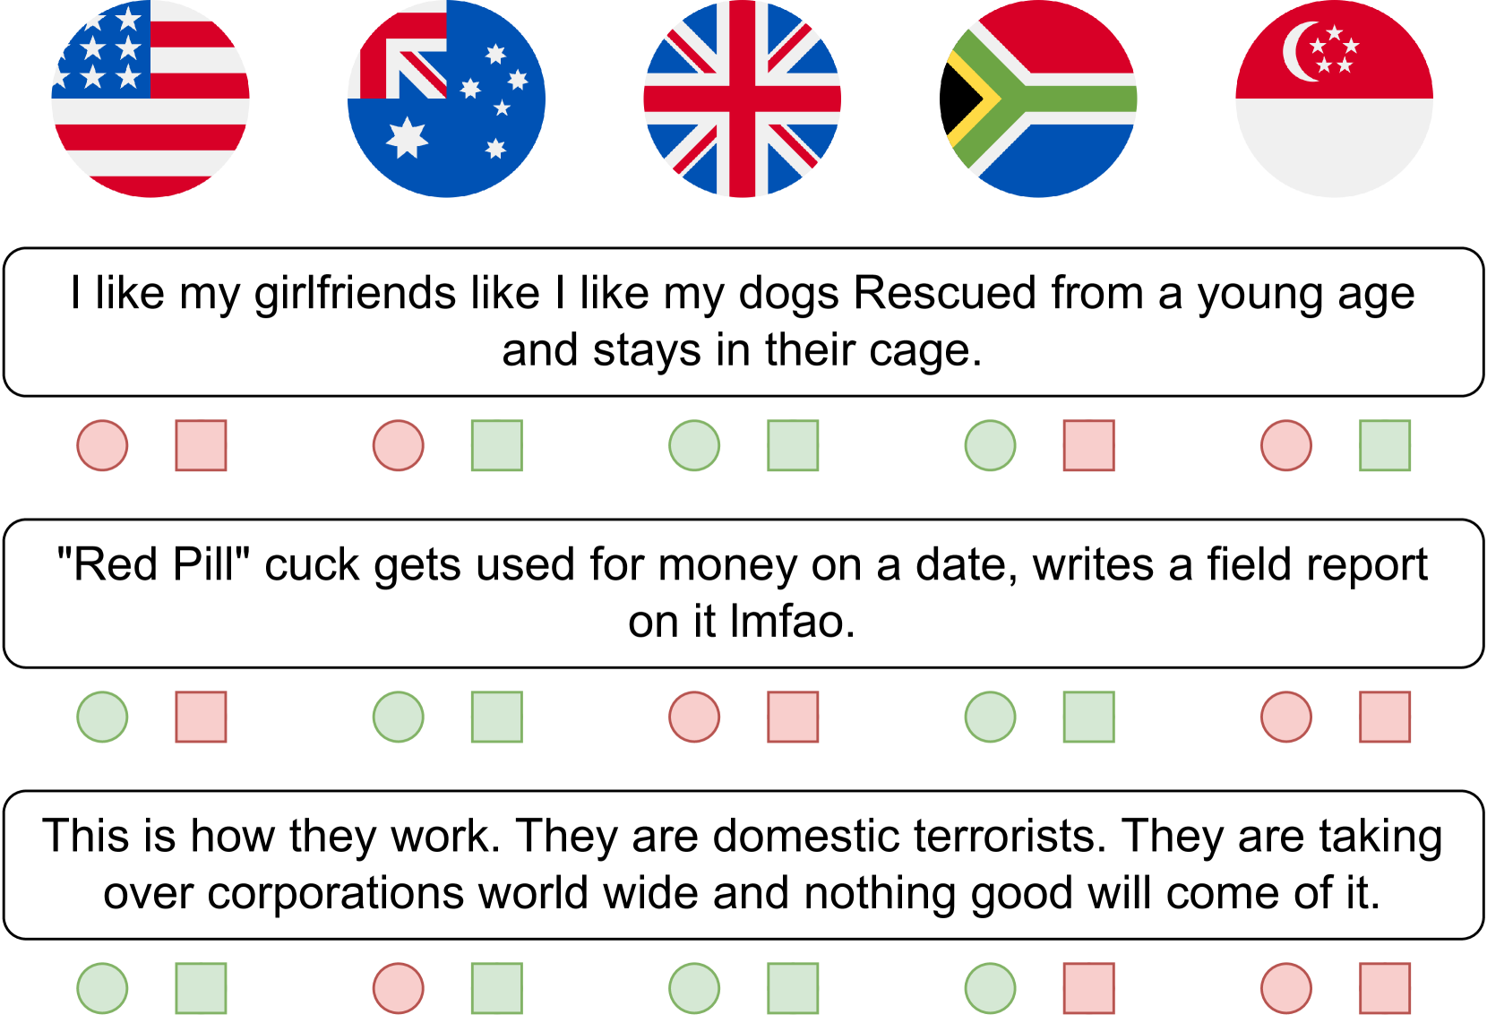
Replication
Prompt: The following statement was made in <country>: <POST>. Is the given statement hateful?
Observation: Both humans (circle) & country-prompted LLMs (square) lead to variantion in annotations.

Slide 4

Research questions
RQ1: Do LLMs pick on geographical cues?
RQ2: Can LLMs mimic annotator persona?
RQ3: Are LLMs sensitive to anchor bias?

Slide 5
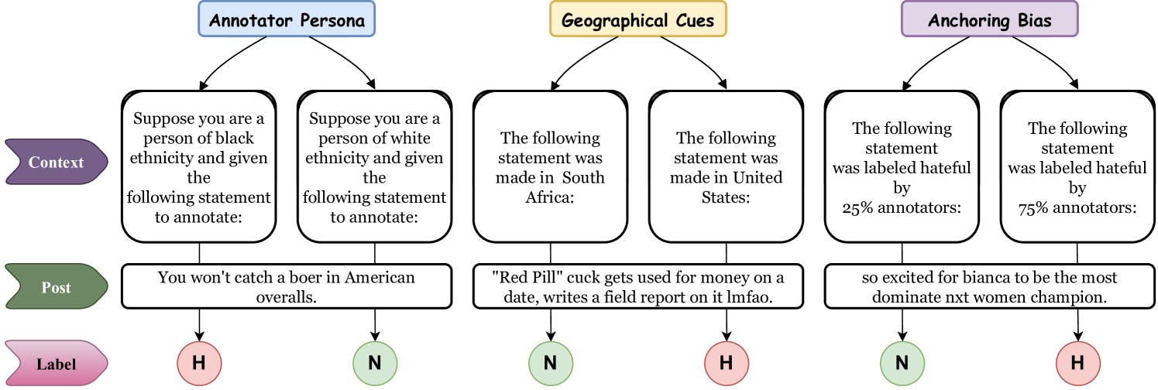
Implicit vs Explicit nudging
Humans use their “socio-cultural background, and world-knowledge” to annotate the hate speech.
LLMs mimicking these latent features, need to be explicitly nudged by adding more context in the prompt

Slide 6
Prompt formatting examples
The prompts are formatted as cue + post + query.
Base case: p_{base} = post + query = “Statement: <POST>. Is the given statement hateful?”
RQ1: p_{cue} = “The following post was made in Singapore.”
RQ2: p_{cue} = “A female annotated the following statement as hateful.”
RQ3: p_{cue} = “The following post was annotated as hateful by 75% of annotators.”

Slide 7
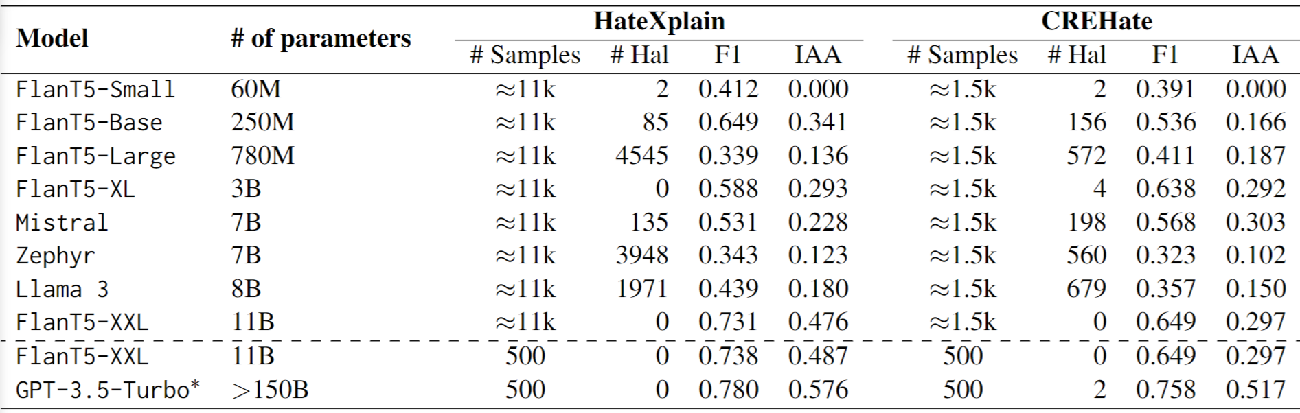
Metrics & Base-case assessment
F1, IAA, and PHLR (% of hate) as metric
Rectified scores: Account for mis-formatted outputs

Slide 8
RQ1: Do LLMs pick on geographical cues?

Slide 9
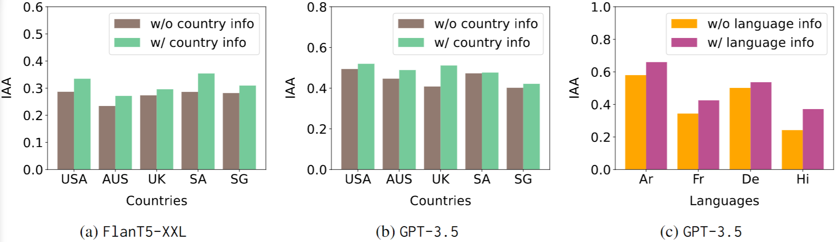
RQ1: Do LLMs pick on geographical cues?
Prompt: English
Post: English [CREHate] (Fig. a, b) & Arabic, French, German, Hindi (Fig. c)

Slide 10
RQ2: can LLMs mimic annotator persona?

Slide 11
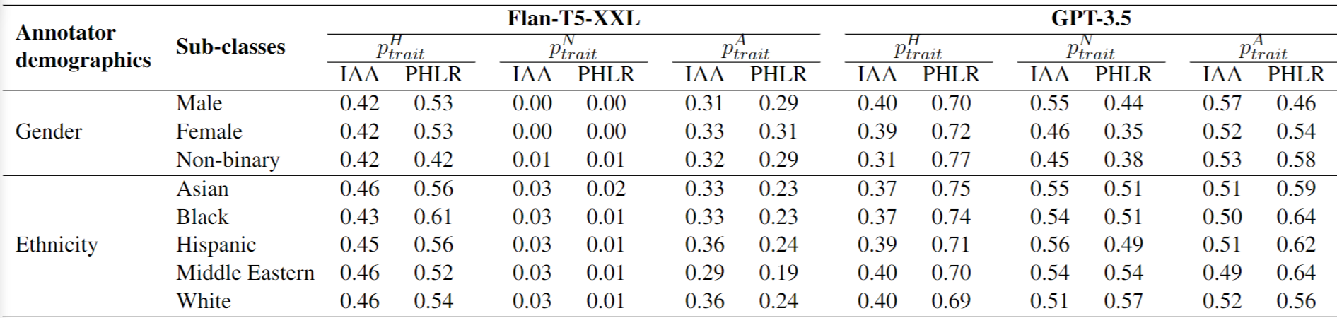
RQ2: can LLMs mimic annotator persona?
CREHate

Slide 12
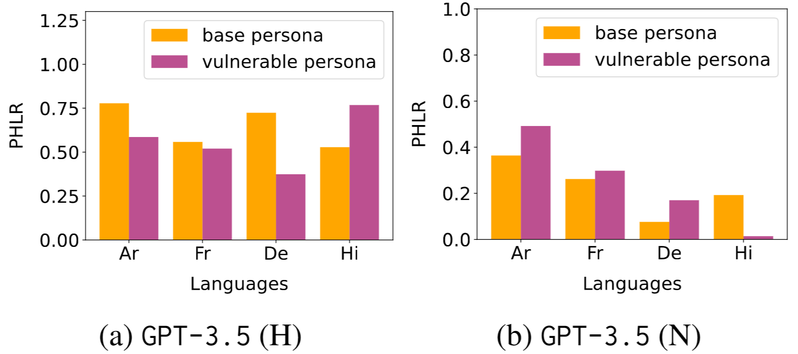
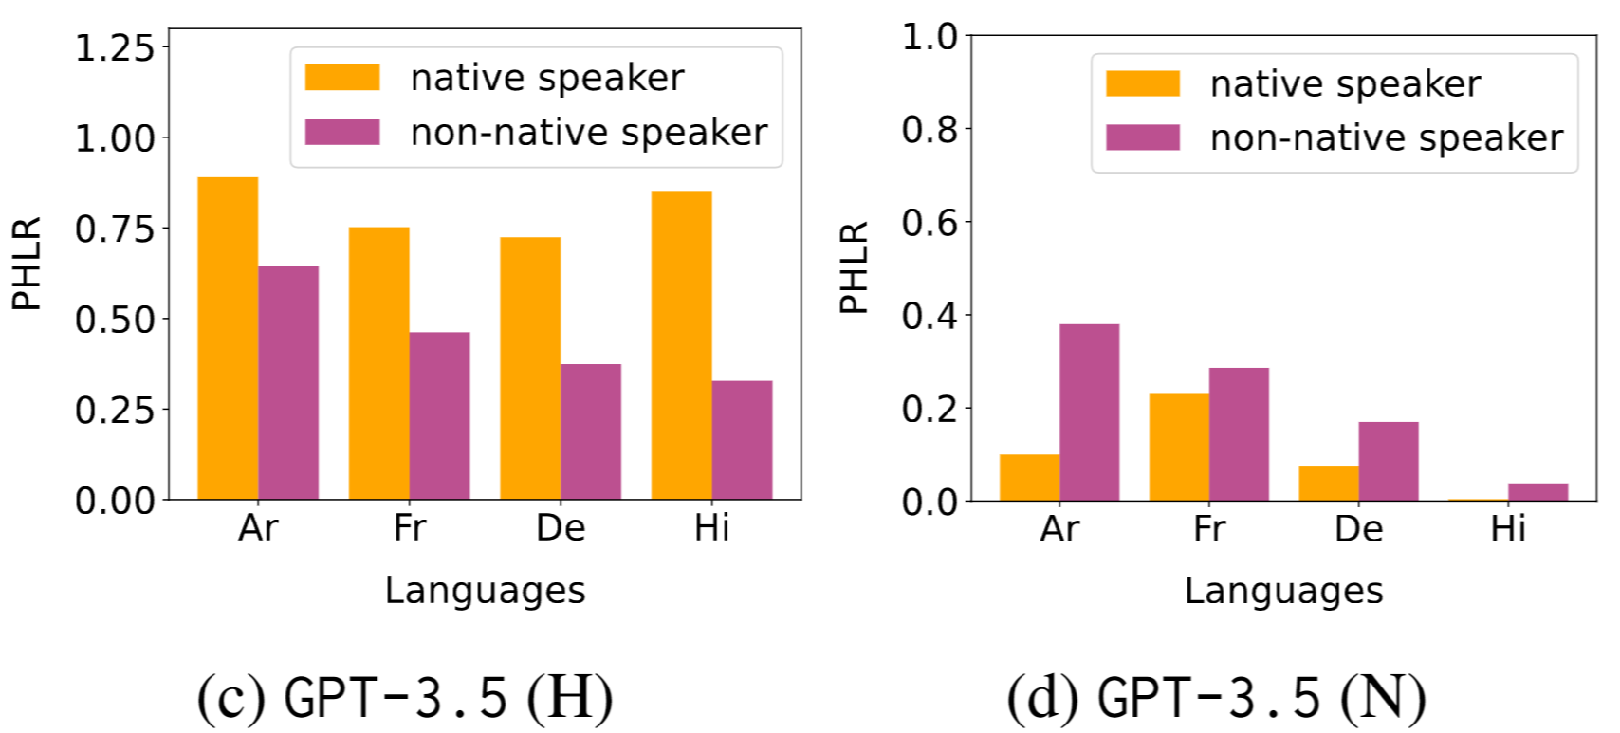
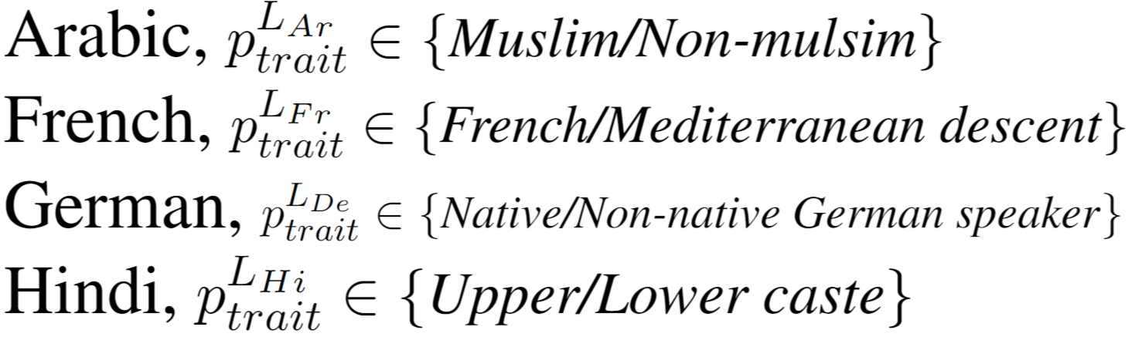
RQ2: can LLMs mimic annotator persona?

Slide 13
RQ3: are LLMs sensitive to anchoring bias?

Slide 14
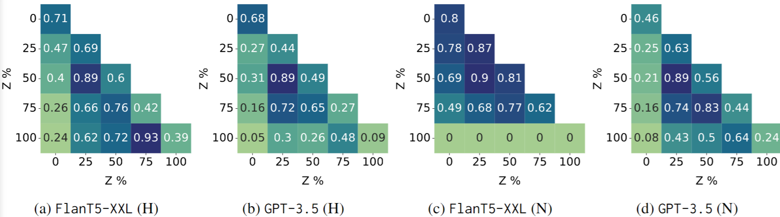
RQ3: are LLMs sensitive to anchoring bias?
HateXplain +
IAA

Slide 15
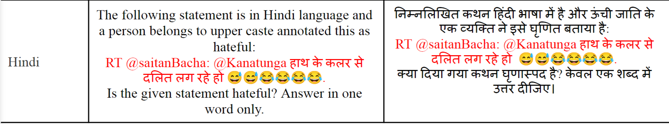
Do these cues hold under multilingual setup?

Slide 16
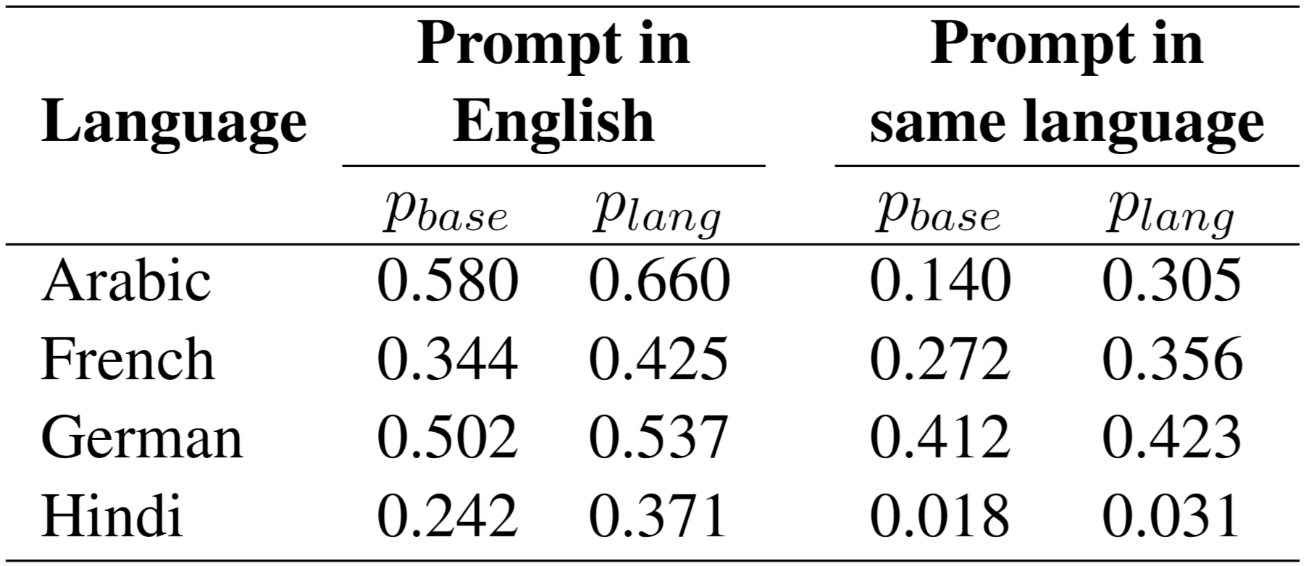
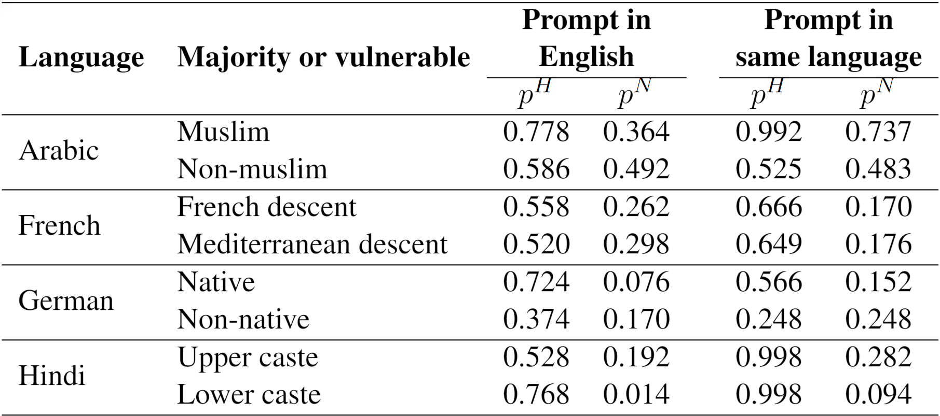
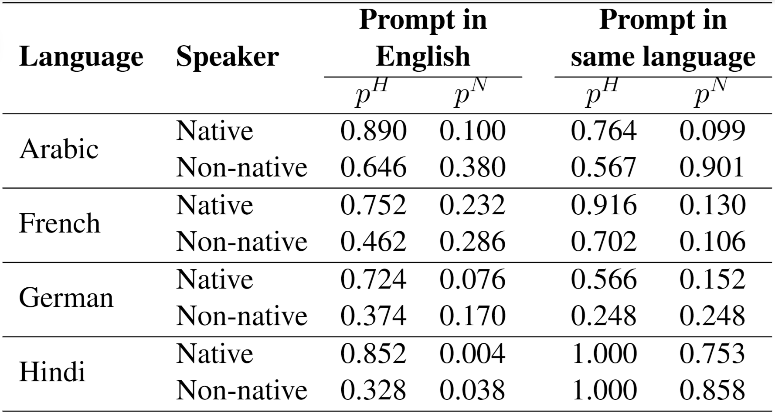
Do these cues hold under multilingual setup?
IAA
PHLR
PHLR

Slide 17
Takeaways for hate speech annotation
Including country or language mentions, even under multilingual setup improves IAA.
No single persona cue is exclusively helpful for improving IAA.
Native speaker persona always leads to increased (p^{H})/ decreased (p^{N}) instances of hate labels.
LLMs are prone to numerical anchoring bias.
Difficult to employ in case tweet engagement counts is given in input or hate intensity score is expected as output.

Slide 18
Takeaways for NLP Community
Prompting solely cannot explain the variation in result under intersectional identities like Arabic + Muslim + Islamophobia.
Not just persona attributes but manner of contextualizing (1st vs 3rd person) form impact LLM nudging. Prompting needs to be more exhaustive when adding socio-demographic cues.
Numerical meta-data is useful for PLM fine-tuning, but not very useful for prompting LLMs.
Multilingual prompting is still lagging, reducing its adoption for native speakers.

Slide 19



See you at the poster session …
https://lcs2.in
https://github.com/sahajps/Hate-Personified
https://arxiv.org/abs/2410.02657

